Slide 1




AT82.02
Data Modeling and Management
Unit 3-2: CAP Theorem
Chutiporn Anutariya (chuti at ait dot ac dot th)

Slide 2
CAP Theorem

Slide 3
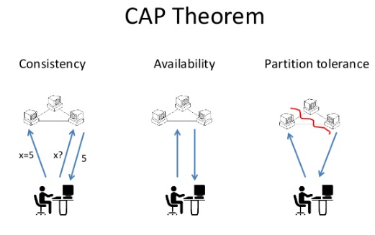

Slide 4
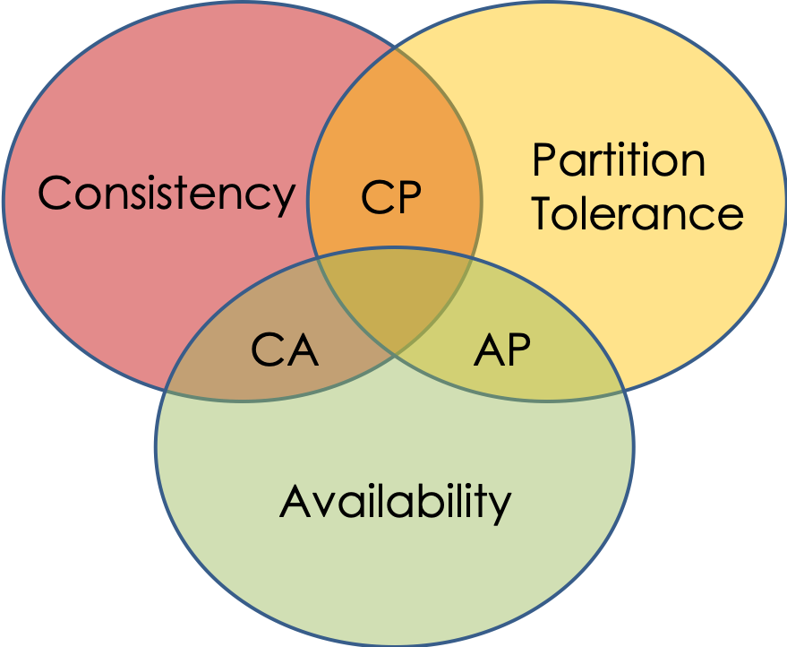
CAP Theorem
The CAP theorem (also called Brewer’s theorem) states that a distributed database system (a networked shared-data system) can only guarantee two out of these three properties:
Consistency
Availability
Partition Tolerance.

Slide 5
CAP Theorem
Consistency
Having a single up-to-date copy of the data
All nodes see the same data at the same time
Availability
Node failures do not prevent other survivors from continuing to operate (a guarantee that every request received by a non-failing node must result in a response)
Partition Tolerance
The system continues to operate despite arbitrary partitioning due to network failures (e.g., message loss)

Slide 6
CAP Theorem: Consistency
A system is said to be consistent if all nodes see the same data at the same time.
Simply, if we perform a read operation on a consistent system, it should return the value of the most recent write operation. This means that, the read should cause all nodes to return the same data, i.e., the value of the most recent write.
Input
Data: “math”
Time: 1:03
Output
Data: “art”
Input
Data: “art”
Time: 1:04

Slide 7
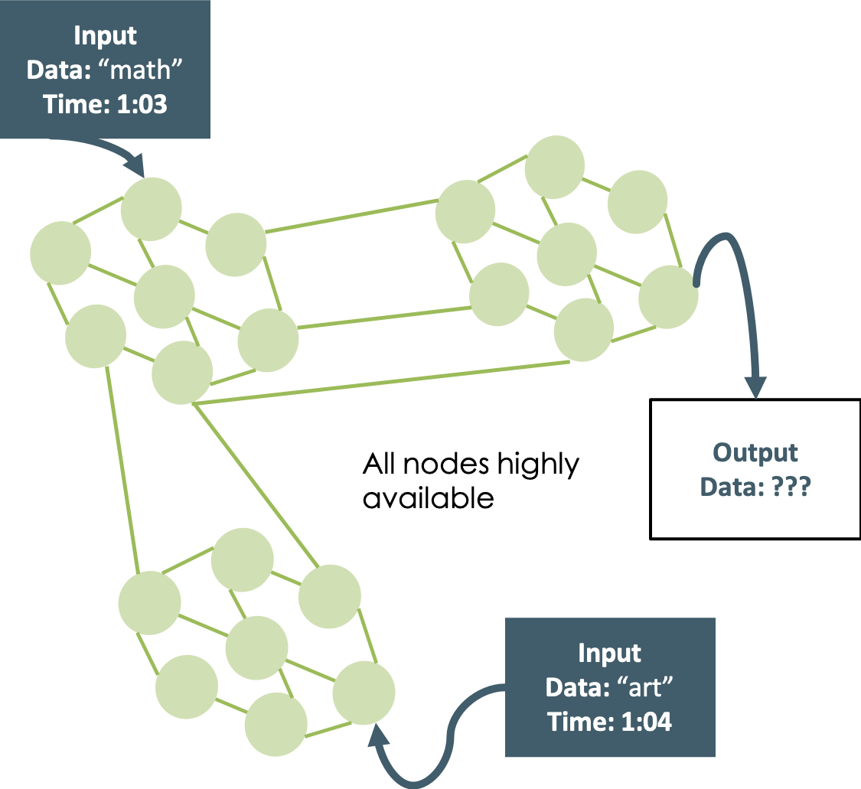
CAP Theorem: Availability
Availability in a distributed system ensures that the system remains operational 100% of the time. Every request gets a (non-error) response regardless of the individual state of a node.
Note: this does not guarantee that the response contains the most recent write.

Slide 8
CAP Theorem: Partition Tolerance
Malfunctioning Node
This condition states that the system does not fail, regardless of if messages are dropped or delayed between nodes in a system.
Partition tolerance has become more of a necessity than an option in distributed systems. It is made possible by sufficiently replicating records across combinations of nodes and networks.
Only one partition is affected

Slide 9
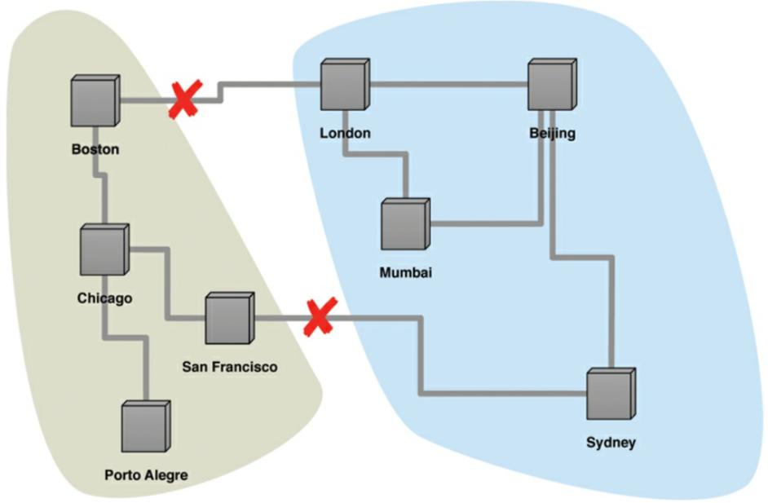
Network Partition
Example of network partition

Slide 10
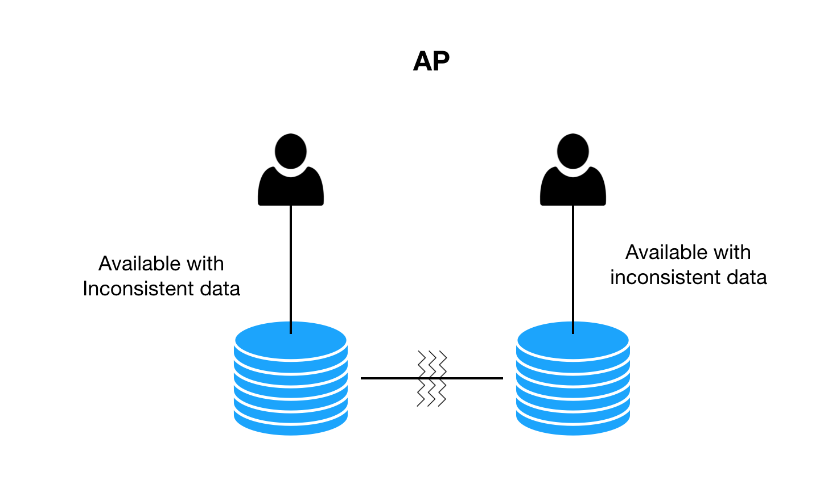
CAP Theorem
The CAP theorem states that in the presence of a network partition, one has to choose between Consistency and Availability.
Meaning that “If you want to be consistent, you can’t always be available”
mango
apple

Slide 11
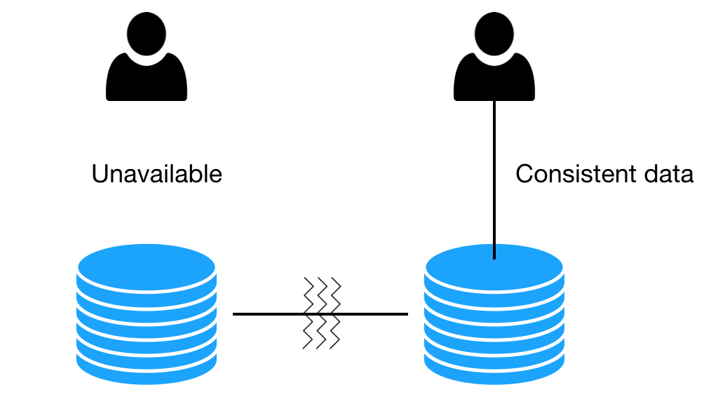
CP: Consistent + Partition Tolerant
When the system replies, you can believe them but they don’t always give your answers

Slide 12
AP: Available + Partition Tolerant

Slide 13

In a system that may suffer from network partitions, as distributed system do, you have to trade off consistency versus availability!
This is not a binary choice, you can trade off a little consistency to get some availability.

Slide 14

Which is right?
Which one to choose AP or CP?

Slide 15

There is no right or wrong.
Choosing what suits best for the use case is the definitive resolution.

Slide 16
Who makes the decision?
The development team or the business?

Slide 17
Criteria to consider:
How important is it to achieve high Availability or is it ok to throw Errors?
How much Latency is tolerated? (high latency approaching ∞ is equal to no availability )
How Complex can a solution get?
What is the cost of achieving Consistency or how much would it cost in the case of Inconsistency?

Slide 18
PACELC
If there is Partition,
how does the system trade-off
between Availability and
Consistency
Else
how does the system trade-off
between Latency and
Consistency
Note: As mentioned before high Latency can be termed as no Availability

Slide 19


What we desire?
High Availability and high Consistency
But we know we can’t have both Availability (low Latency) and Consistency when there is network Partition ????
How about having high Availability (low Latency) over Consistency for the time being and getting Eventually Consistent?

Slide 20

P. Sadalage and M. Fowler: NoSQL Distilled: A Brief Guide to the Emerging World of Polyglot Persistence, Addison-Wesley Professional, 2013

Slide 21

Thank you.
Let’s Summarize!

